Slide 1
Parinayam (matrimonial web regstration form)
TRACK1-TS- WEB CAPSTONE PROJECT
Presented By:
1. H.LAHARI BAI-21RU5A0504
2. M.UMA DEVI-20RU1A0535
3.S.ALEKHYA-20RU1A0550
4.Y.PAVITHRA-21RU5A0511
Guided By:HRISHIKESH MAHURE

Slide 2

OUTLINE
Abstract
Problem Statement
Proposed System/Solution
System Design
System Development
Approach(Technology Used)
Algorithm & Deployment
Future scope
Conclusion
Output screenshot
References

Slide 3

Abstract
Matrimony registration forms serve as a vital document in the process of legalizing and formalizing marital unions. These forms are a fundamental aspect of matrimonial documentation, aiding in the creation of a comprehensive record of individuals seeking to enter into the sacred institution of marriage. The abstract for a matrimony registration form encapsulates the essential components and purposes of such forms.

Slide 4
Problem Statement
In the digital age, matrimonial websites have become a popular platform for individuals seeking life partners. However, the effectiveness and user experience of these platforms heavily rely on the design and functionality of their registration forms. The problem statement for a matrimony website registration form focuses on addressing the challenges and shortcomings associated with this crucial component.
The problem statement for a matrimony website registration form recognizes the challenges and areas of improvement in creating a seamless, user-friendly, and secure registration experience. Addressing these issues is vital for the success and trustworthiness of matrimonial websites in helping individuals find their life partners.

Slide 5
User Assistance
User Feedback and Iteration
Testing and Quality Assurance
Education and Awareness
By implementing these proposed solutions, the matrimonial website can create a registration form that not only addresses the identified challenges but also enhances user satisfaction, security, and trust.
This, in turn, will contribute to the overall success and credibility of the platform in helping individuals find their life partners.

Slide 6
Proposed Solution
To address the challenges and shortcomings outlined in the problem statement for a matrimonial website registration form, the following proposed solutions aim to create a more efficient, user-friendly, and secure registration process:
User-Centric Design
Progress Indicators
Mobile Optimization
Data Validation
User Authentication
Privacy Controls
Cultural Sensitivity

Slide 7
System Architecture
Designing a system architecture for a matrimony registration form involves planning the components, data flow, and interactions required to create a robust and scalable platform. Here's a high-level system architecture for a matrimony registration form:
User Interface (UI)
Application Layer
Authentication and Security
Database Layer
Application Logic
External Services and APIs
Feedback and Reporting

Slide 8
System Deployment Approach
Deploying a system, such as a matrimony registration form, involves a series of steps to make it accessible and functional for users. Here's a deployment approach to guide you through the process:
Infrastructure Setup
Environment Configuration
Code Deployment
Database Setup
Security Measures

Slide 9
Monitoring and Logging
Data Migration
Testing
Backup and Recovery
DNS Configuration
Content Delivery
Performance Optimization
Documentation
Rollout and Monitoring
User Communication
Support and Maintenance
Training
Scaling Strategy
Disaster Recovery and Redundancy
Compliance and Legal

Slide 10
Algorithm & Deployment
Algorithm :Algorithm Development
Data Preprocessing
Model Training (if applicable)
Optimization and Fine-Tuning
Version Control
Scalability Considerations
Security Measures
Performance Monitoring
Logging and Error Handling
Testing and Quality Assurance
User Training and Documentation (if applicable)
Compliance and Regulations (if applicable)
Ongoing Maintenance
Performance Optimization (Post-Deployment)
Documentation and Knowledge Sharing

Slide 11
Deployment:
Integration with Application
Deployment Environment
Deployment Process
User Acceptance Testing (UAT)
Rollback Plan
User Support
Rollout and Monitoring
Security Measures
Data Management (if applicable)
Scaling Strategy
Compliance and Regulations (if applicable)
Training and Skill Transfer
Continuous Improvement
Backup and Recovery
Version Control
Infrastructure Setup
Accessibility and User Feedback
Monitoring and Analytics
Content Delivery
Legal Compliance

Slide 12
Future scope
It provide platform to a lot of bride/groom for finding perfect match.
There are different sectors like Matrimonial regstration,Partner,
Search,etc. So the bride/groom can get their interest for find their partner.

Slide 13

CONCLUSION
Designing a matrimony registration form is a complex process that involves careful consideration of user experience, data privacy, and effective matching algorithms. It plays a crucial role in facilitating connections between individuals seeking life partners. By following best practices in form design, data security, and user engagement, you can create a platform that not only captures essential user information but also helps foster meaningful relationships. Continuous maintenance, updates, and user support are essential to ensure the long-term success and satisfaction of users on your matrimony registration platform.

Slide 14
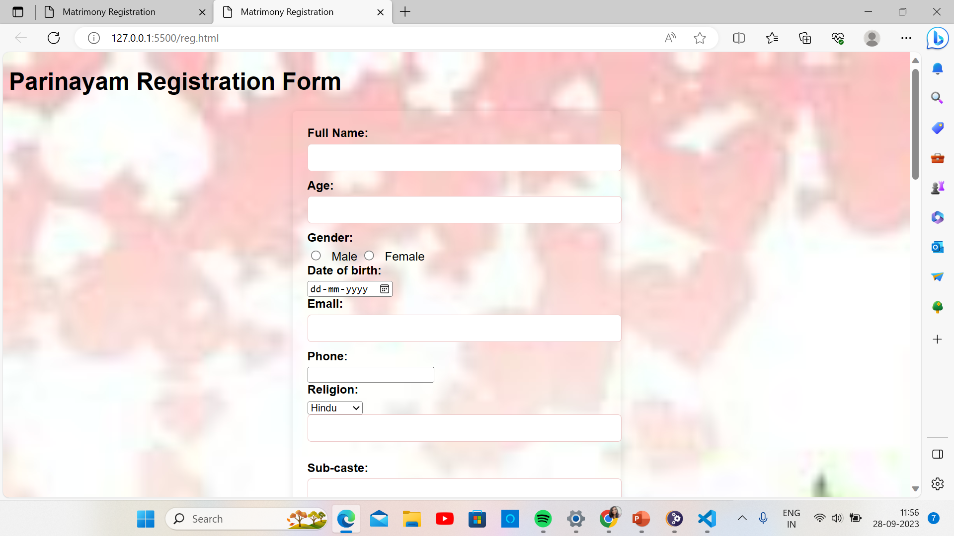
Output screenshots

Slide 15
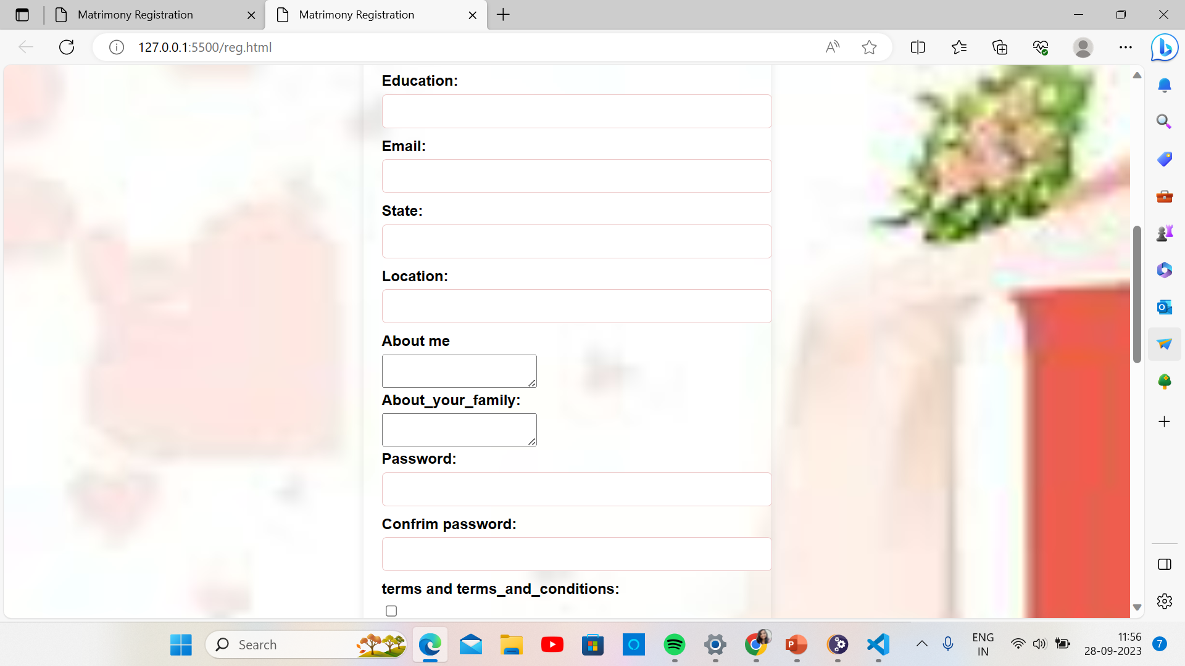

Slide 16
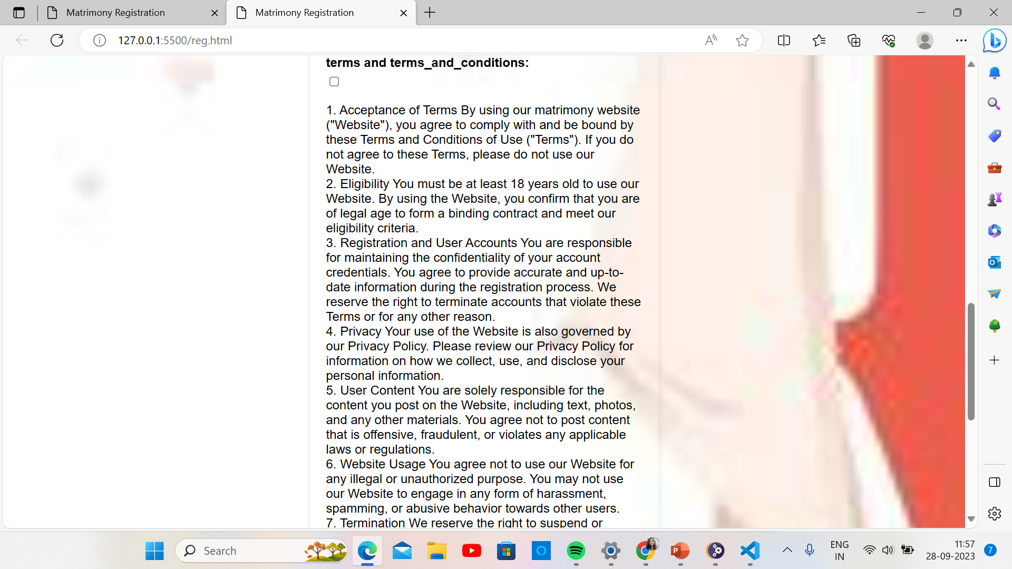

Slide 17
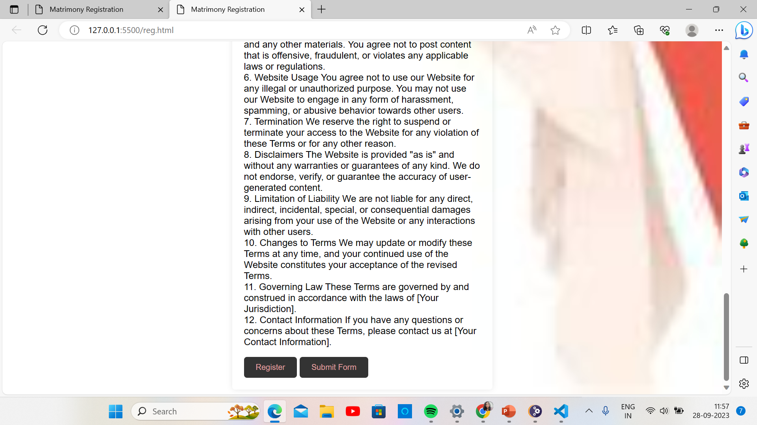

Slide 18
REFERENCE
https://www.shaadi.com/lets-begin/matrimony?ptnr=scgenexgma148224&aff_url_param=g&gclid=CjwKCAjw3oqoBhAjEiwA_UaLtpaIBrD0tli9gbnWWEx6fY3G2VuccBTLPDl3aXDPgtr7bK_pMRA8eRoCC1cQAvD_BwE
Lovevivah.com: Indian Marriage, Matrimonial, Matrimony Sites ...
Lovevivah.comhttps://www.lovevivah.com
https://www.jeevansathi.com/m0/homepage/index

Slide 19
Github link
click here

Slide 20

THANK YOU

